Slide 1


Slide 2
About me
Shibel Alshech
22 years old
Student at The Open University
Student at 5TECH QA Automation program

Slide 3

Asana website
Project Management: Asana is a web-based tool for project and task management.
Collaboration: Enables team collaboration and communication on projects.
Task Tracking: Allows users to create, assign, and track tasks and deadlines.
Integrations: Supports integration with various apps like Slack, Google Drive, and more.
User-Friendly: Features a user-friendly interface with customizable workflows.

Slide 4
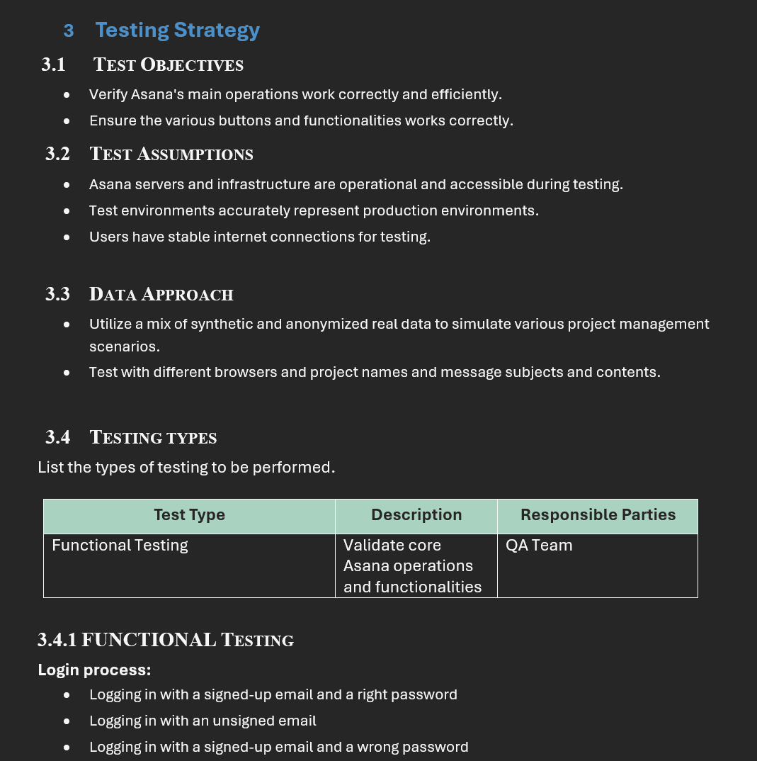
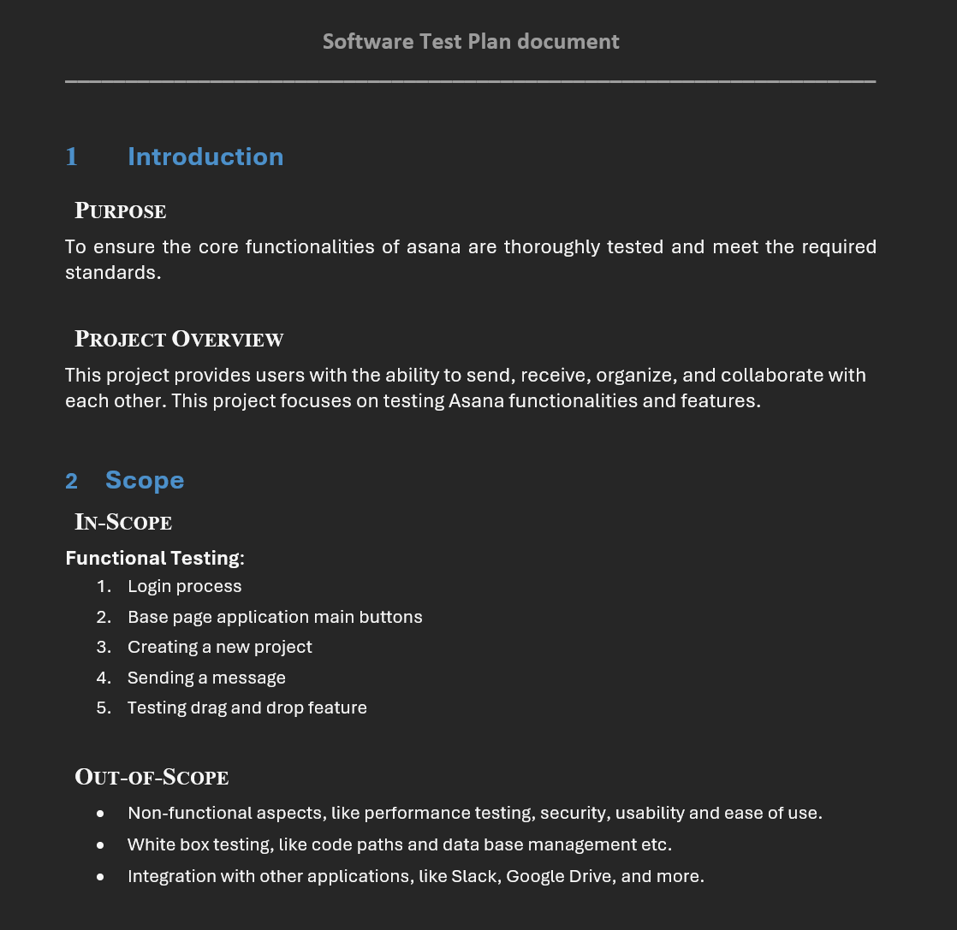
STP Document

Slide 5
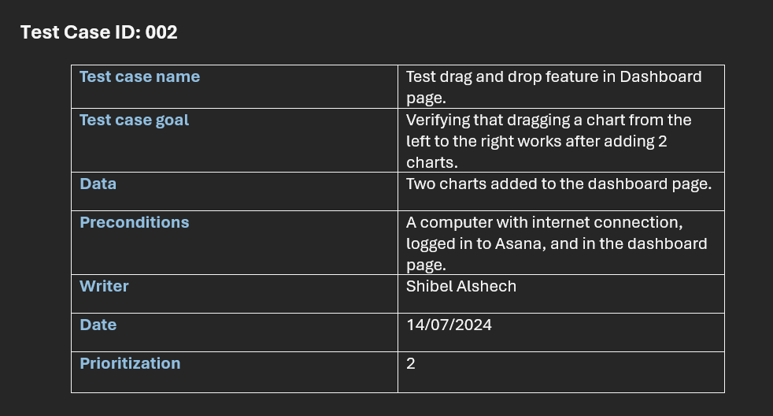
STD Document

Slide 6
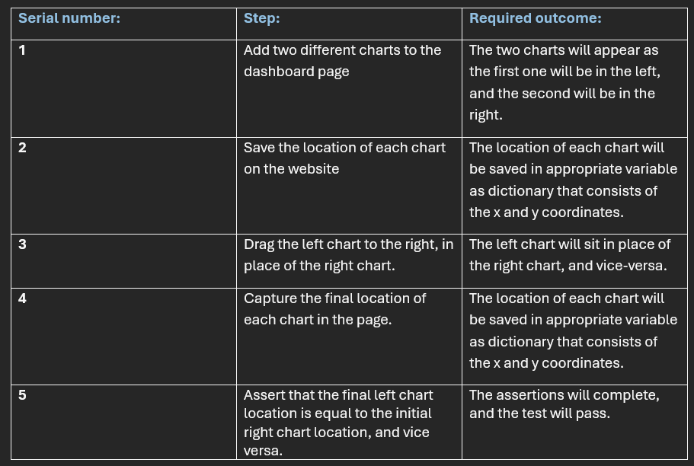
STD Document – Test Case

Slide 7

Now let’s see the code!

Slide 8
Thank you for listening!

